Slide 1
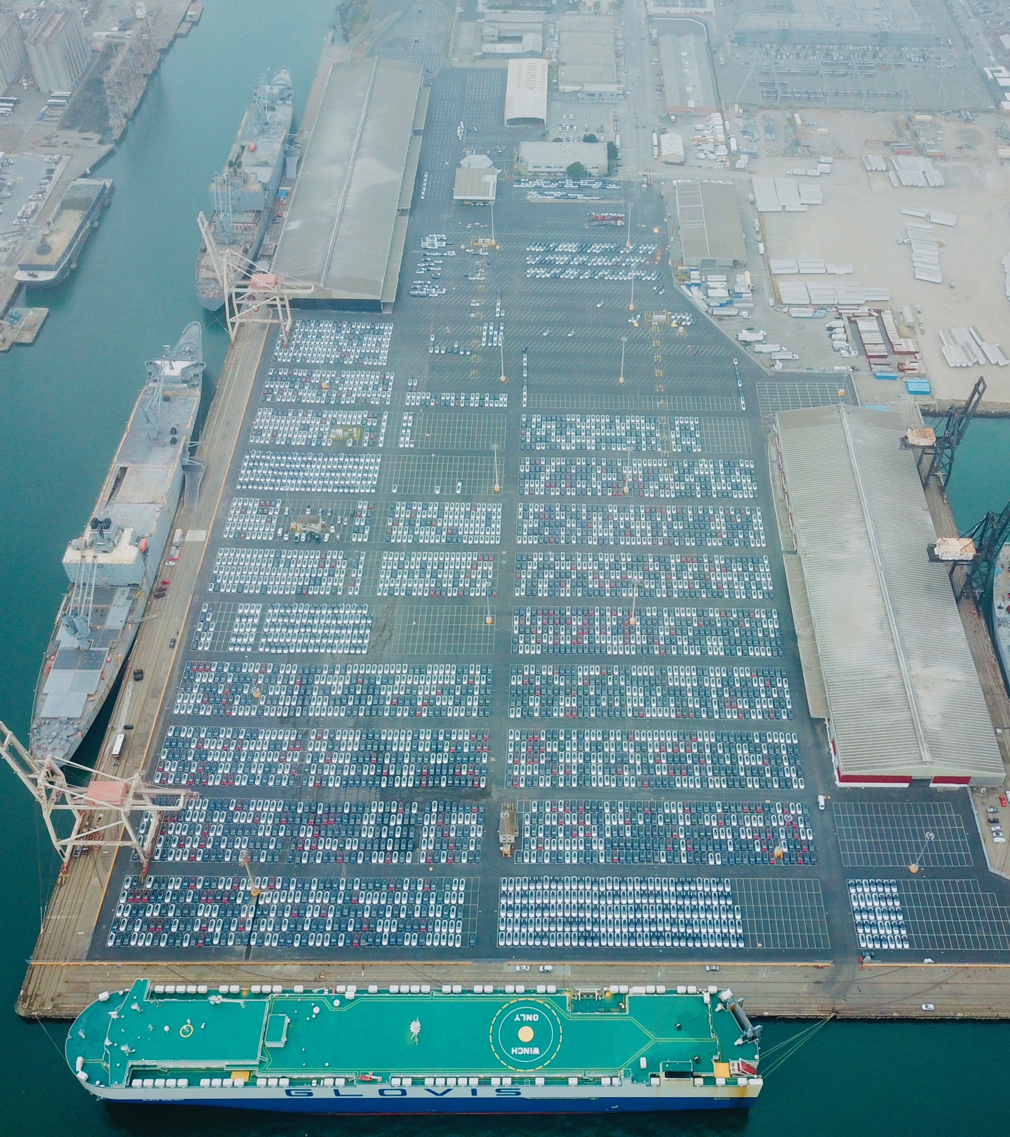
Maritime Cargo Update

Slide 2
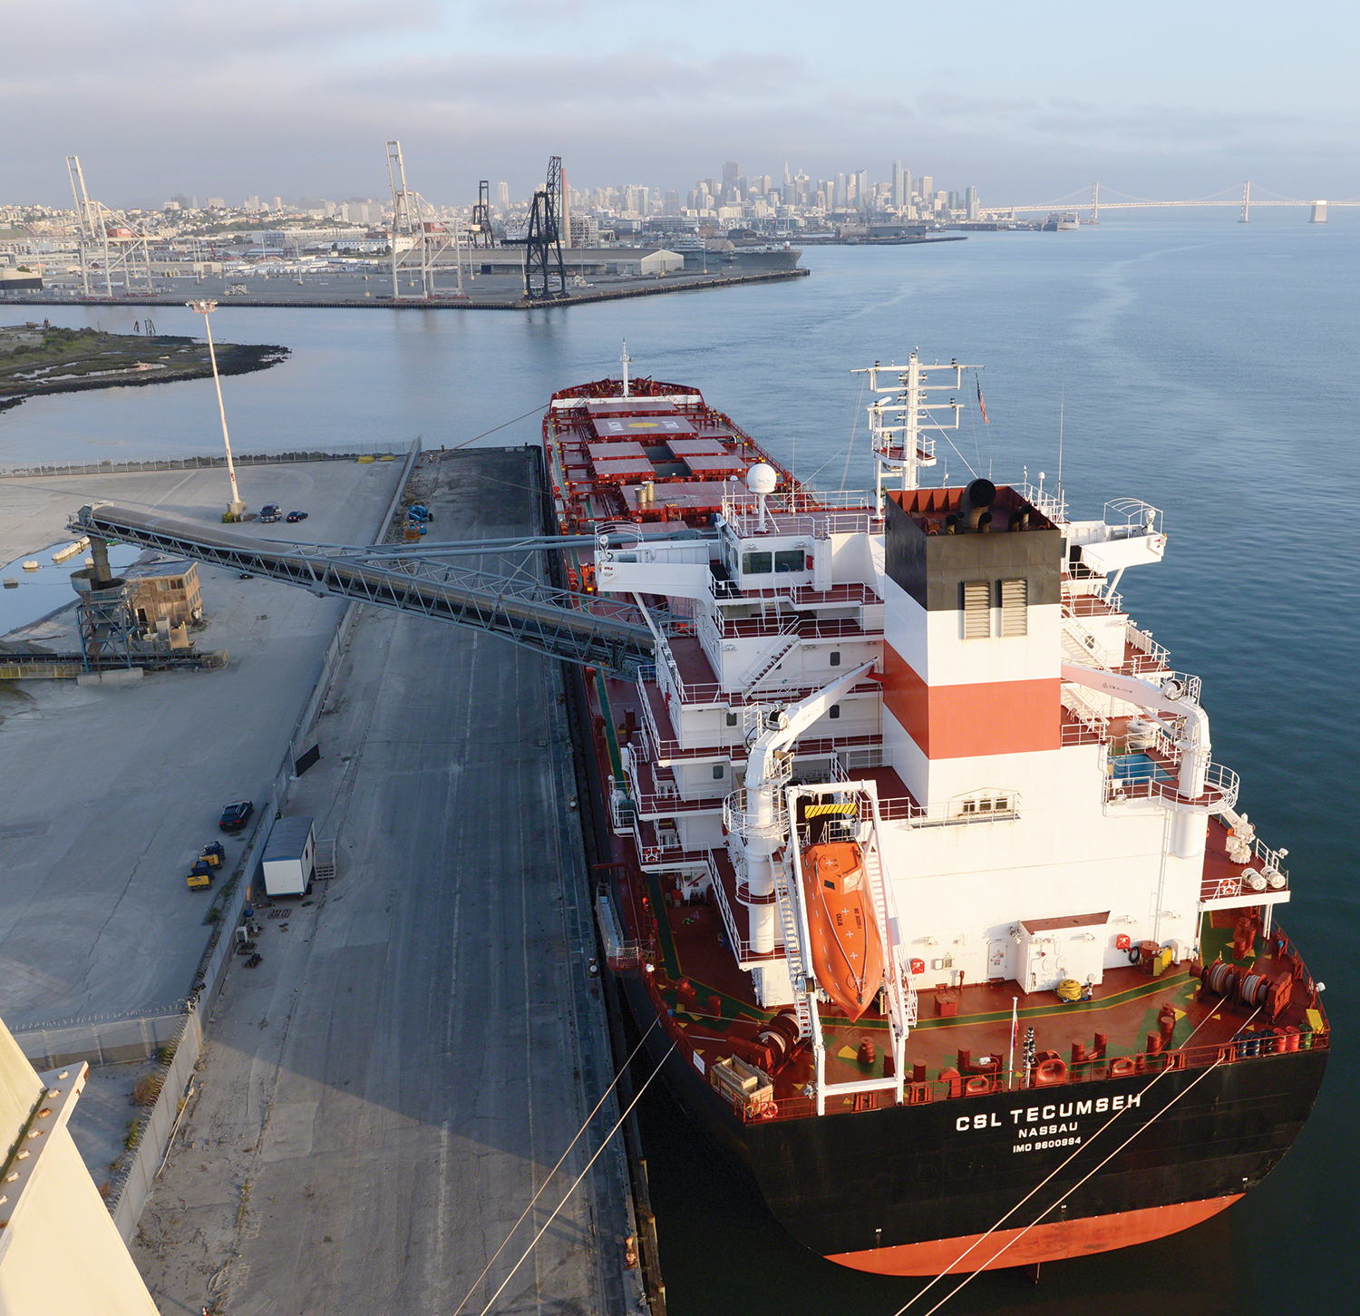
Maritime Cargo Update

Slide 3
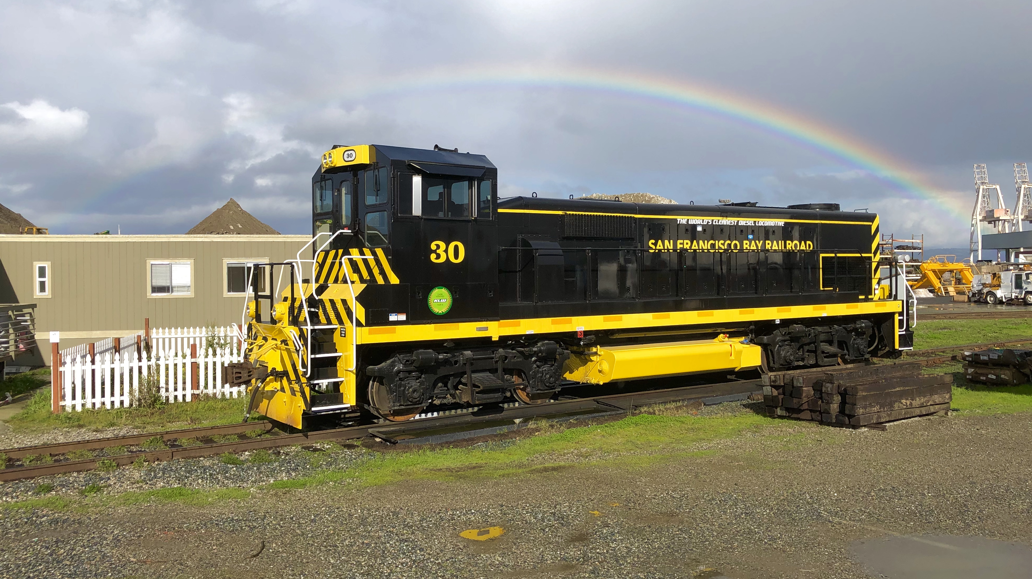
Maritime Cargo Update

