Slide 1
CWAG and SWAC Meeting
December 5, 2019

Slide 2
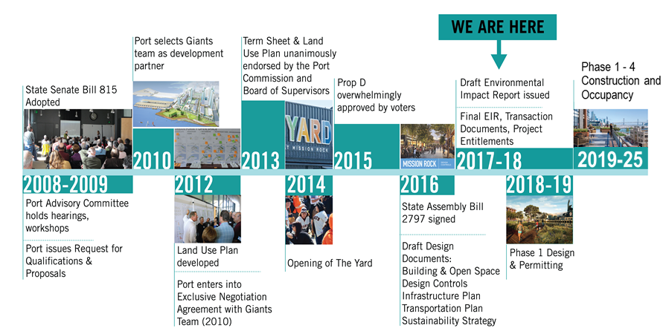

Slide 3
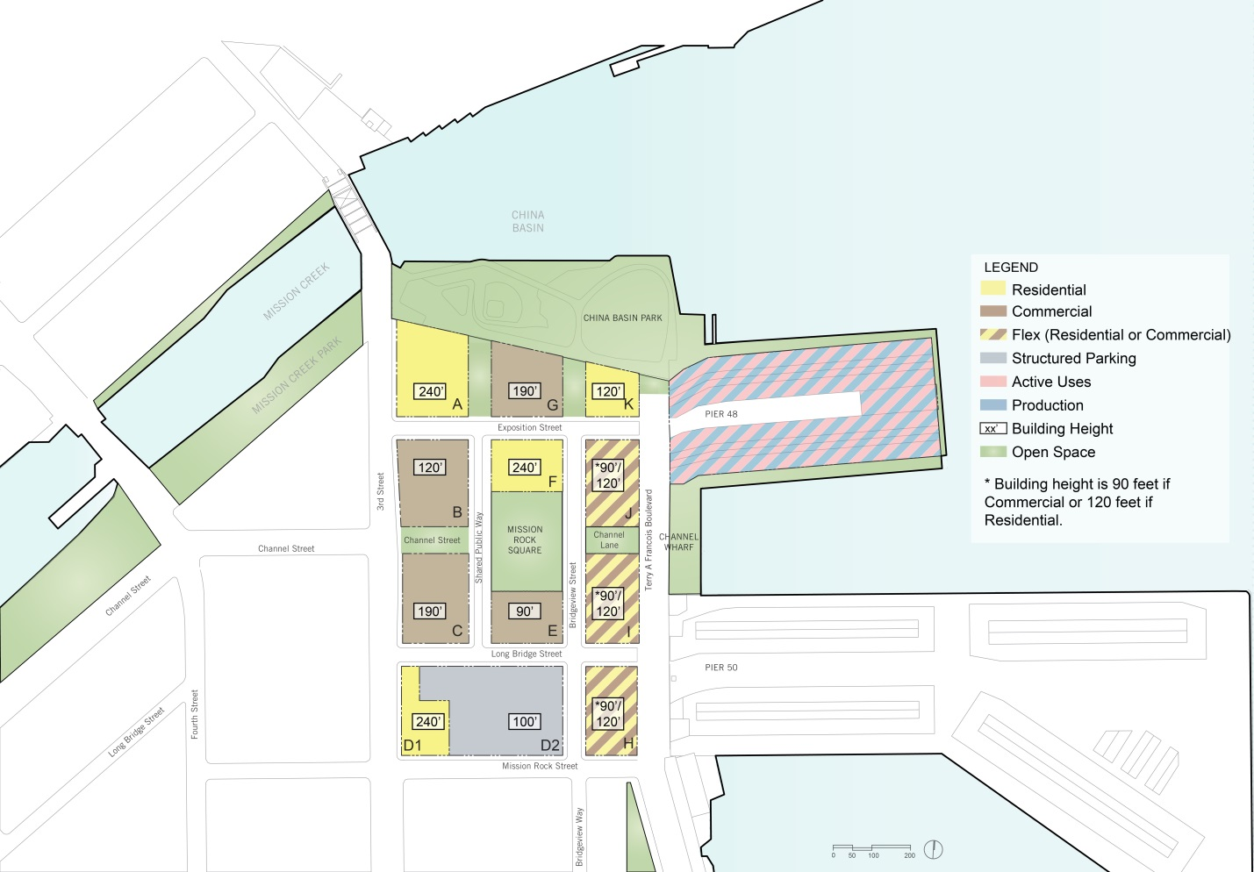
PROJECT LAND USE
3

Slide 4
Neighborhood Facts
11
buildings
Approximately
8 Acres
PROJECT OVERVIEW
1200
parks & open space
new homes
40% affordable

Slide 5
PROJECT LAND USE
5

Slide 6
Phase 1 includes
550K GSF
of office
Approximately
65K GSF
PROJECT OVERVIEW
550
of retail
rental homes including affordable & family units

Slide 7
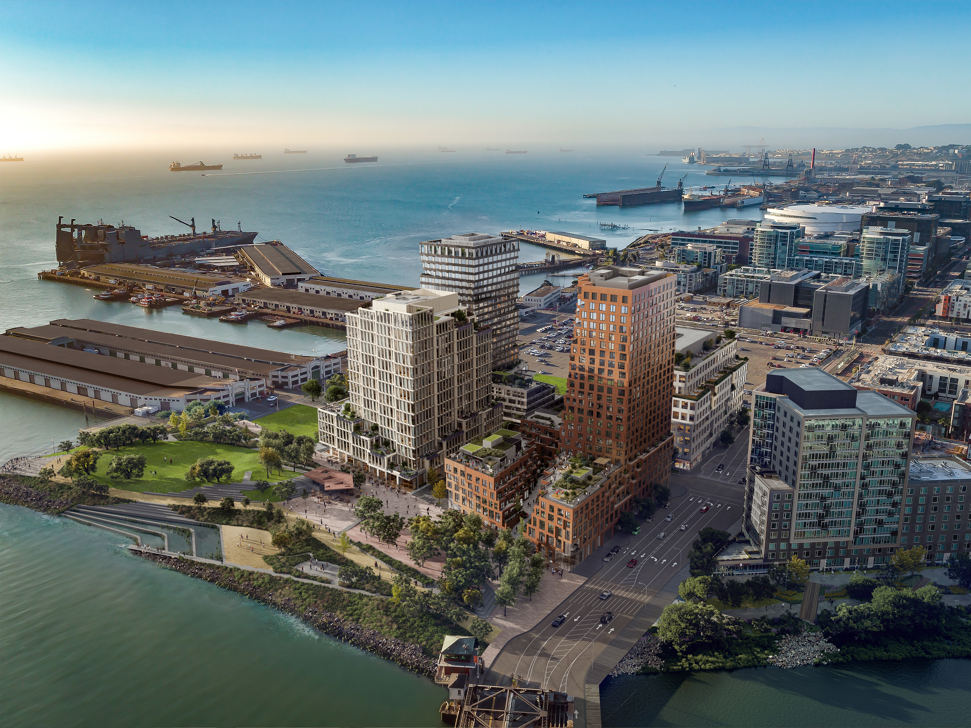

Slide 8
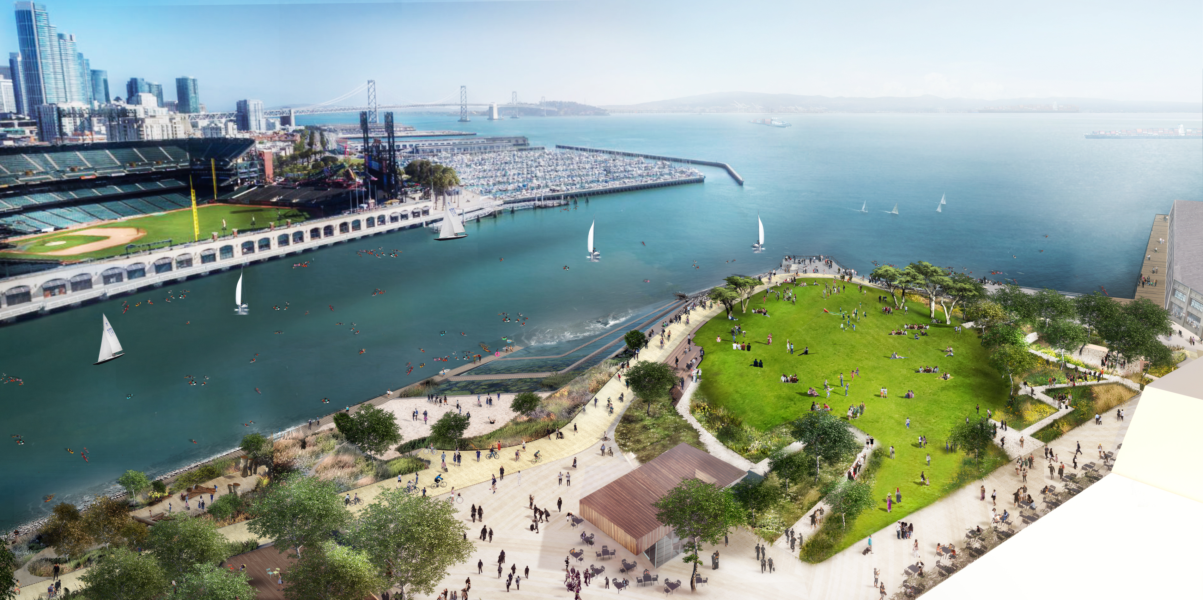

Slide 9
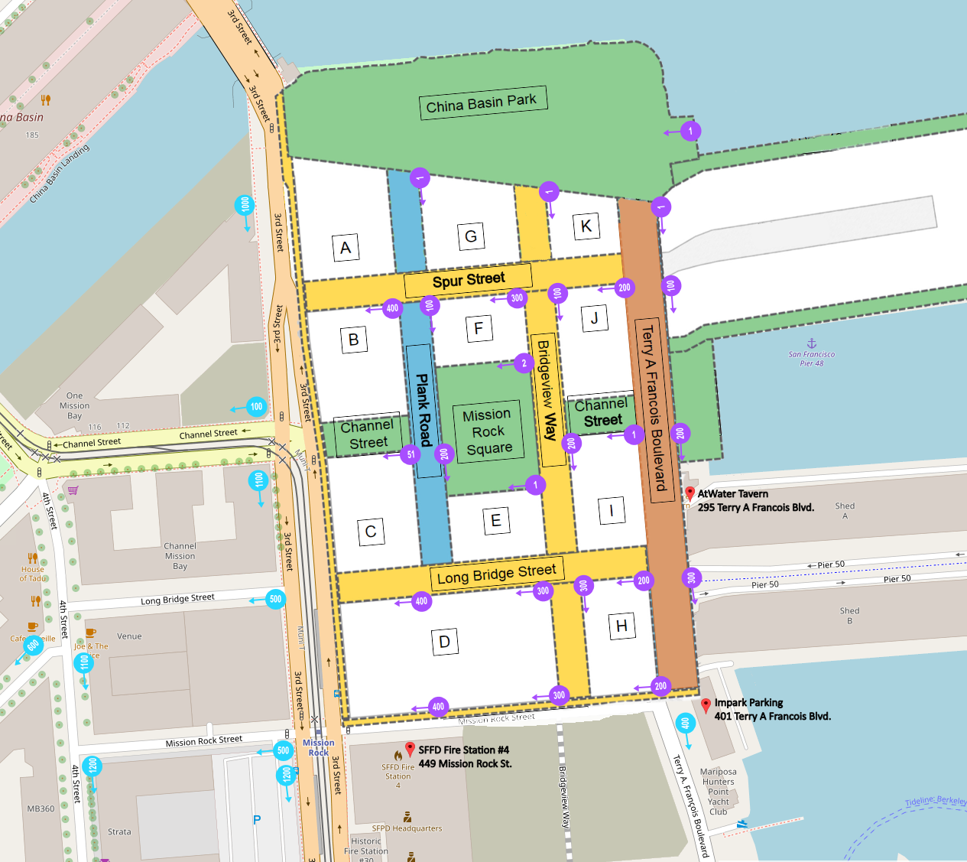

Slide 10
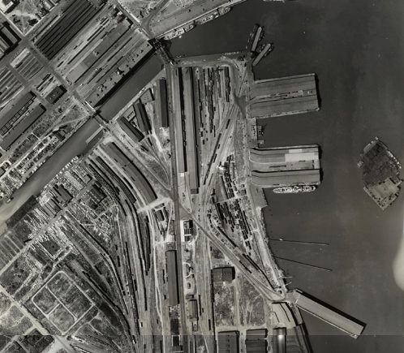
Mission Bay area, Rail yards use visible, circa 1938
Photo Credit: Harrison Ryker collection, David Rumsey map collection

Slide 11
Phil Williamson
Senior Project Manager
415-274-0453
phil.williamson@sfport.com

